Slide 1
DeepClimb
Nathan Cho
Computational Science and Engineering
Yonsei Univ.

Slide 2
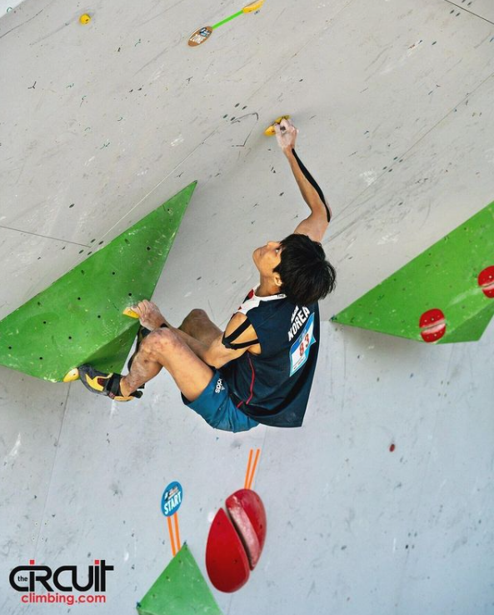
Motivation
Climbing will be included in the Olympics for the first time in history in summer 2021, in Tokyo, Japan.

Slide 3
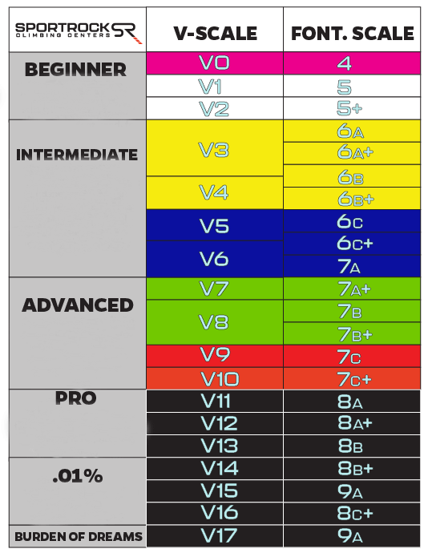
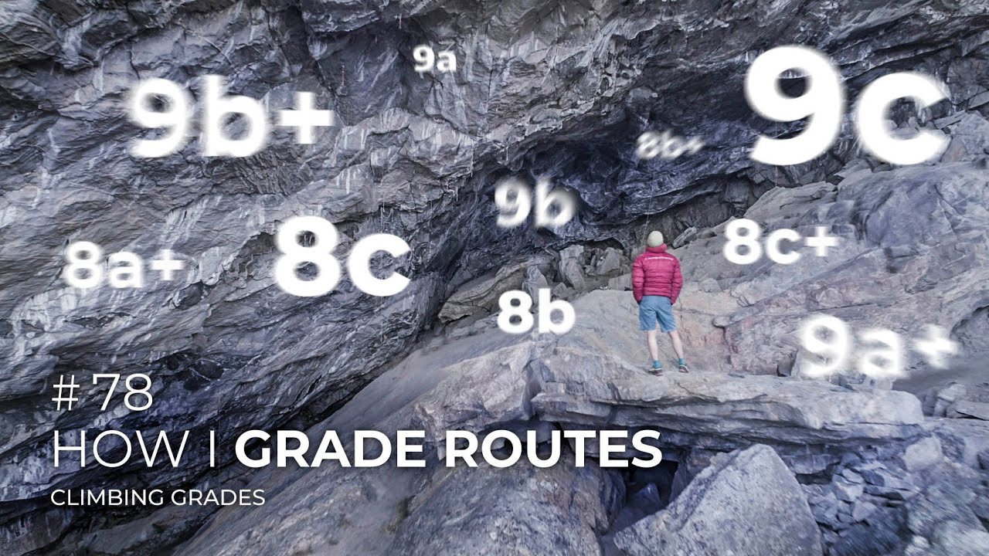
Motivation
Climbing will be included in the Olympics for the first time in history in summer 2021, in Tokyo, Japan.
Every problem has a grade, but it is subjective.

Slide 4
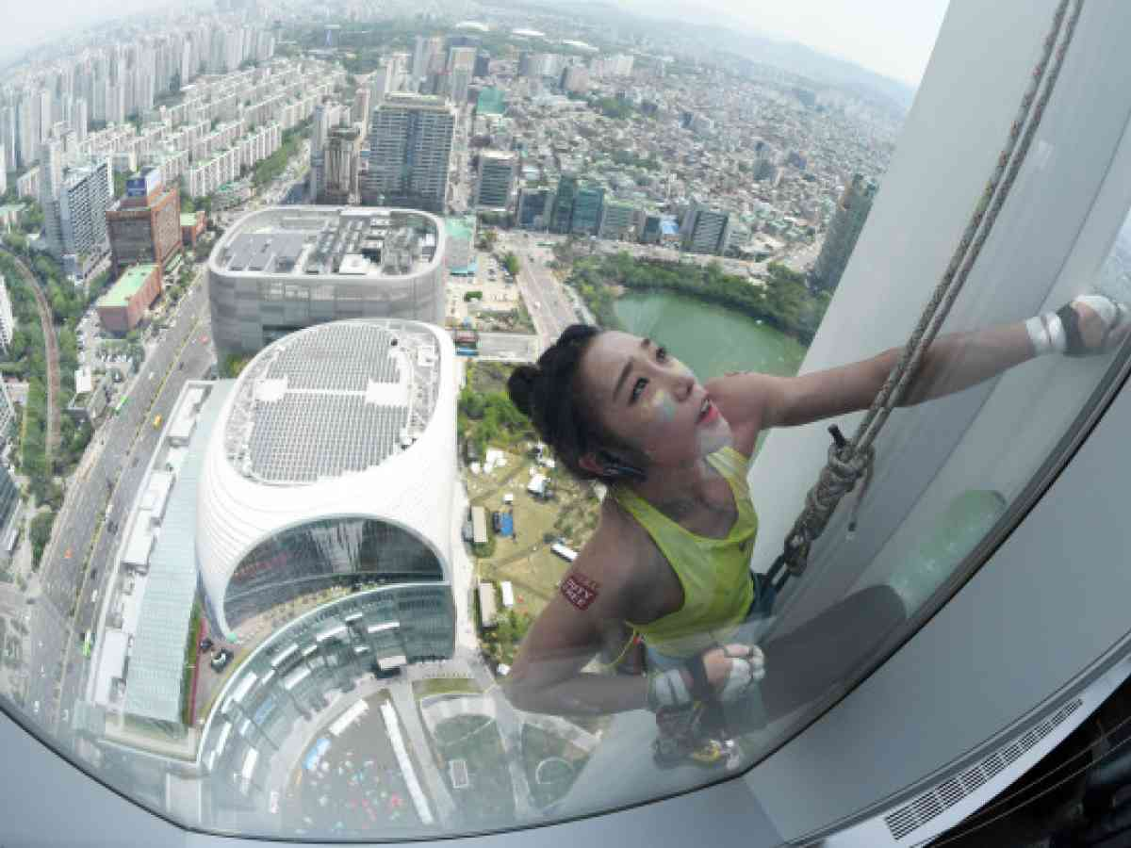

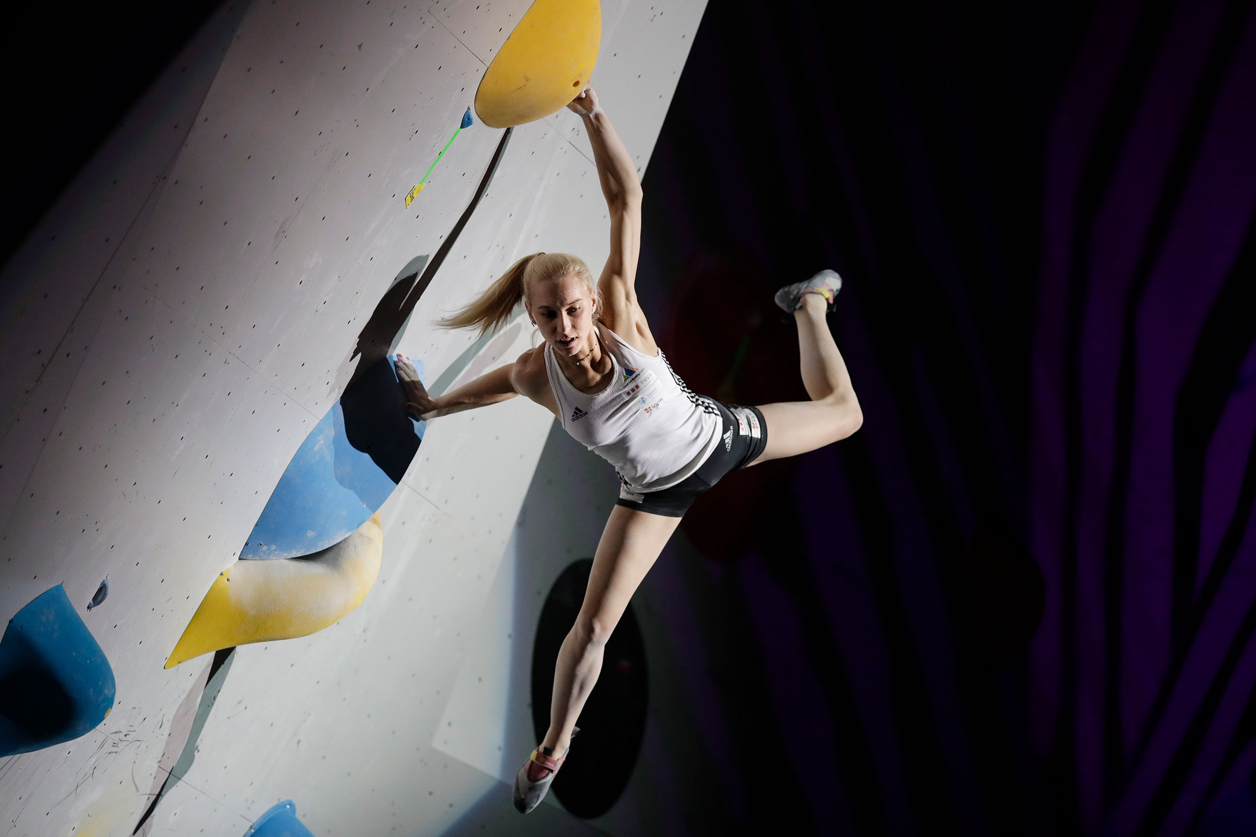
Motivation
Climbing will be included in the Olympics for the first time in history in summer 2021, in Tokyo, Japan.
Every problem has a grade, but it is subjective.
Every wall is different: holds, friction, wall angle, complexity, etc.
allezjain
janja_garnbret

Slide 5
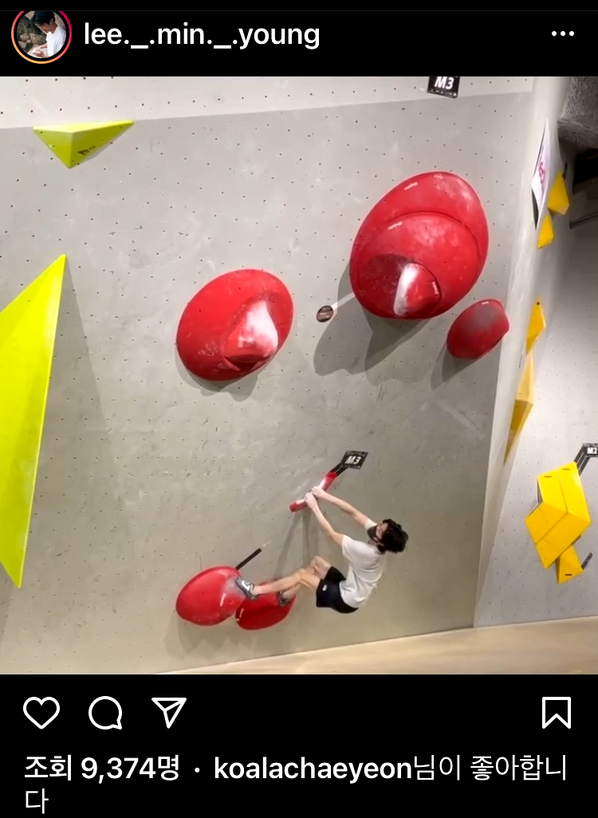
Motivation
Climbing will be included in the Olympics for the first time in history in summer 2021, in Tokyo, Japan.
Every problem has a grade, but it is subjective.
Every wall is different: holds, friction, wall angle, complexity, etc.
Near impossible for a machine to grade a problem just by inputting a photo of the problem.

Slide 6
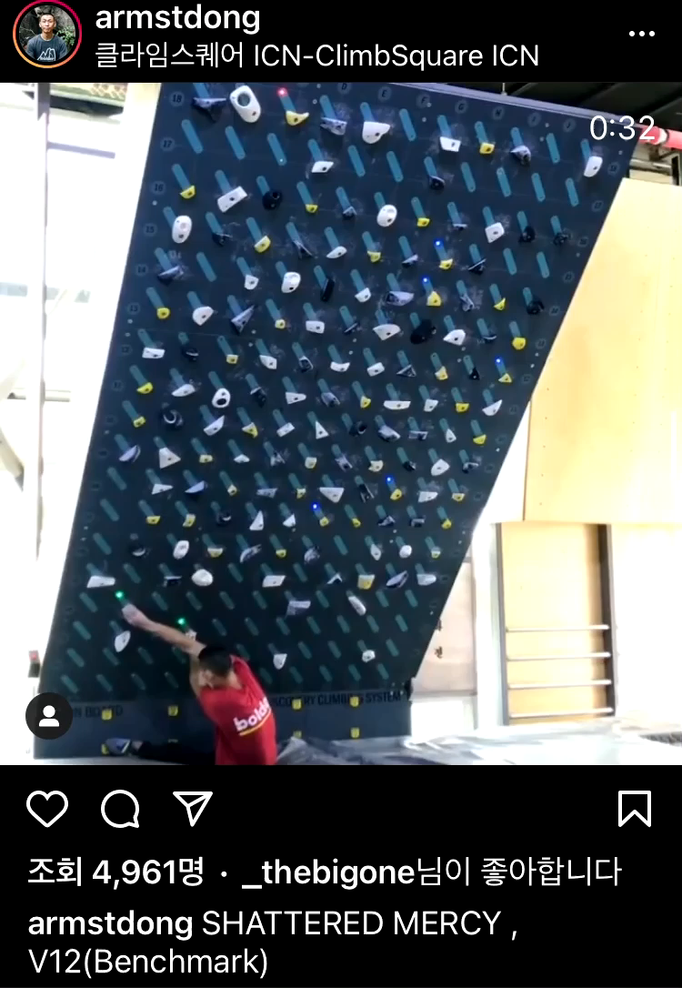
Motivation
Climbing will be included in the Olympics for the first time in history in summer 2021, in Tokyo, Japan.
Every problem has a grade, but it is subjective.
Every wall is different: holds, friction, wall angle, complexity, etc.
Near impossible for a machine to grade a problem just by inputting a photo of the problem.
If only there were a standardized setting…

Slide 7
Objectives
To create a climbing problem grade classifier
To identify hold similarities and create new problems

Slide 8
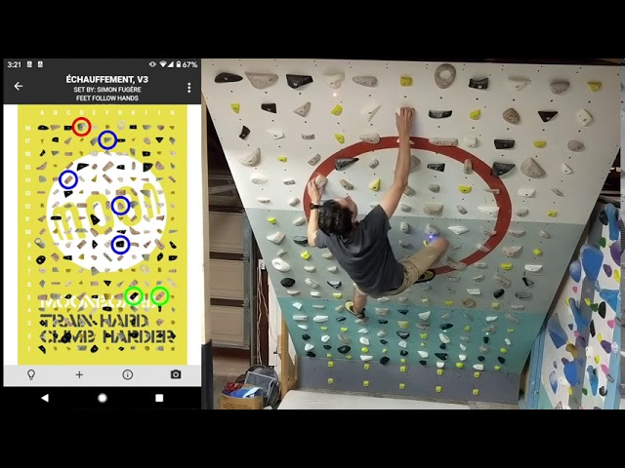
SEtting
Standardized board: MoonBoard

Slide 9
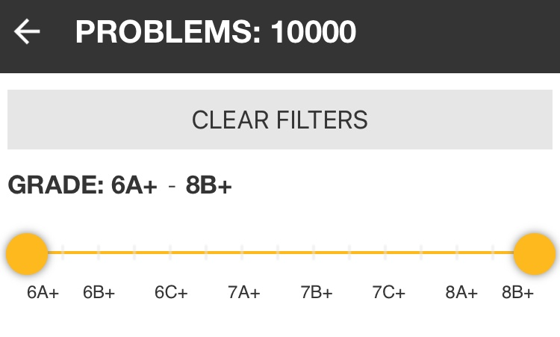
SEtting
Standardized board: MoonBoard
Thousands of problems, each labeled with grades

Slide 10
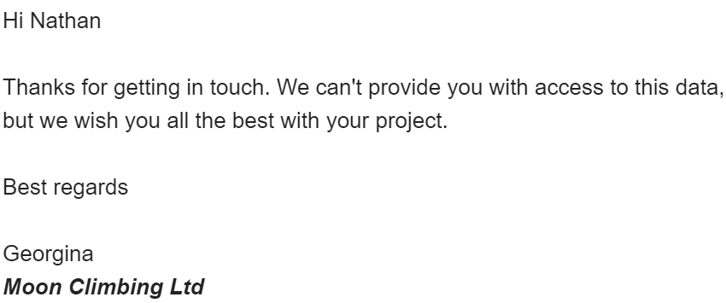
Data acquisition
E-mail: failed
Data Scraping

Slide 11
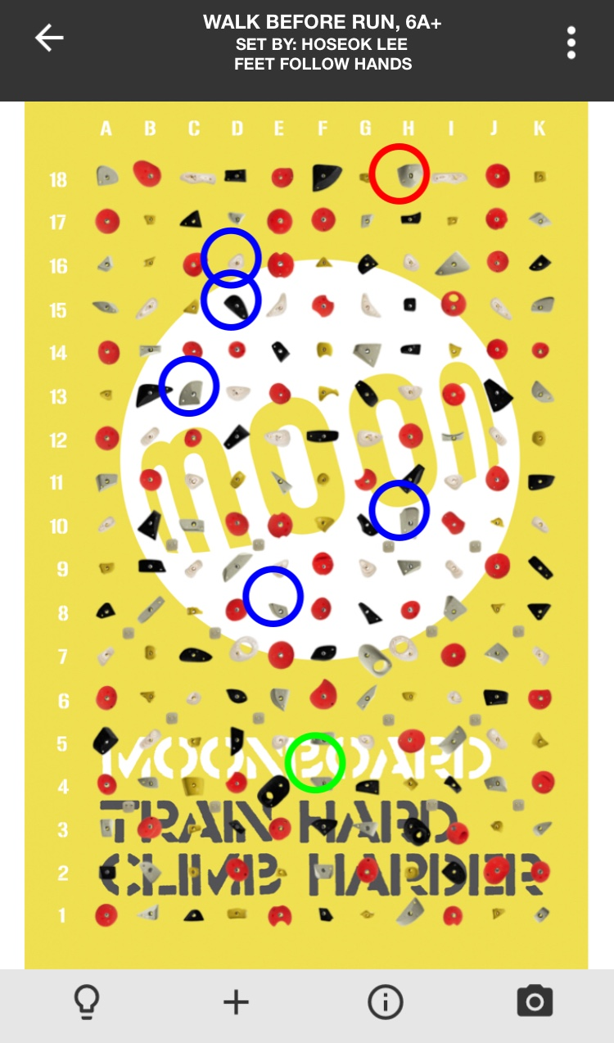
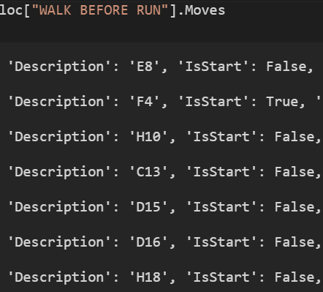
Data pre-processing
Input: holds
Output: difficulty

Slide 12
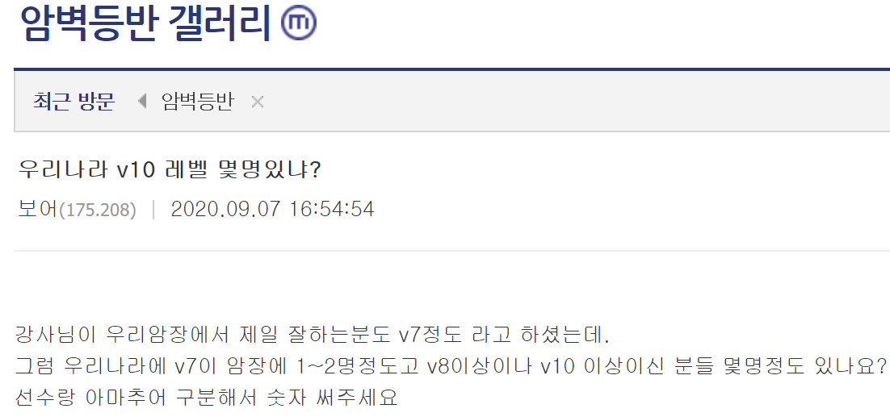
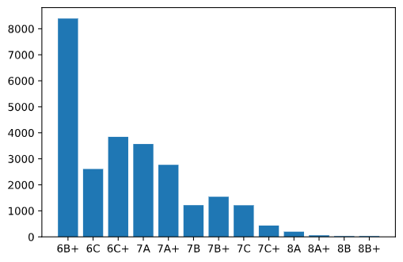
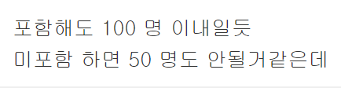
Data pre-processing
Even the easiest MoonBoard problems are hard for the average climber (top 10%)
Skewed data: Every guess could be 6B+ with decent accuracy
Less ambitious take: try classifying up to 7A+
Down-sample 6B+ based on problem repeats
How many V10’s (7C+) are there in Korea?
Less than 50 amateurs,
Less than 100 if professionals are included

Slide 13
Multi Layer Perceptron
Notice each problem is a vector.

Slide 14
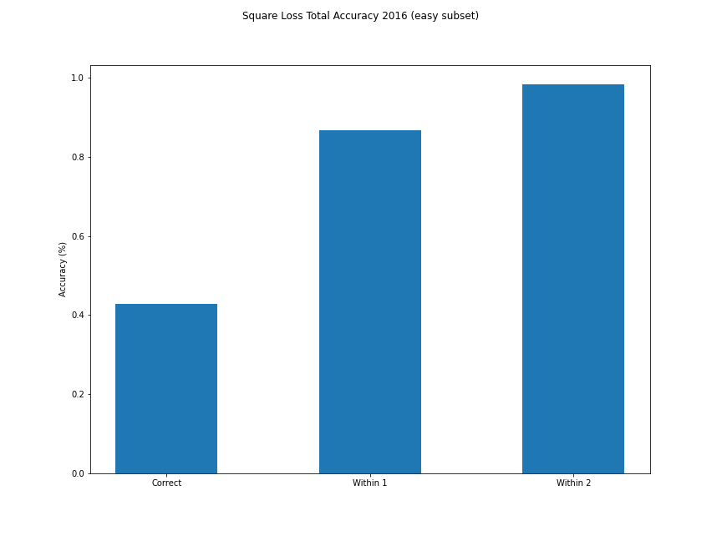
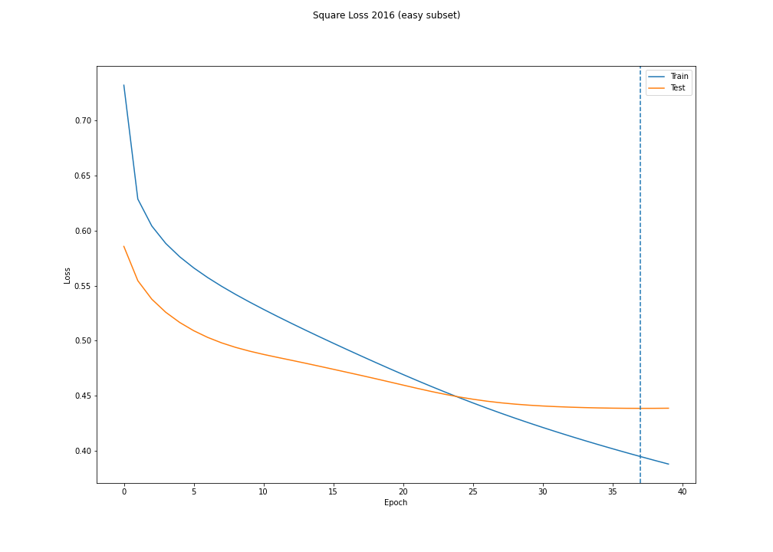
Multi Layer Perceptron (Square Error)
One study showed experts get about 45% exactly correct, and 87.5% correct within one grade.
Square error algorithm on test data: 0.4293 & 0.8675

Slide 15
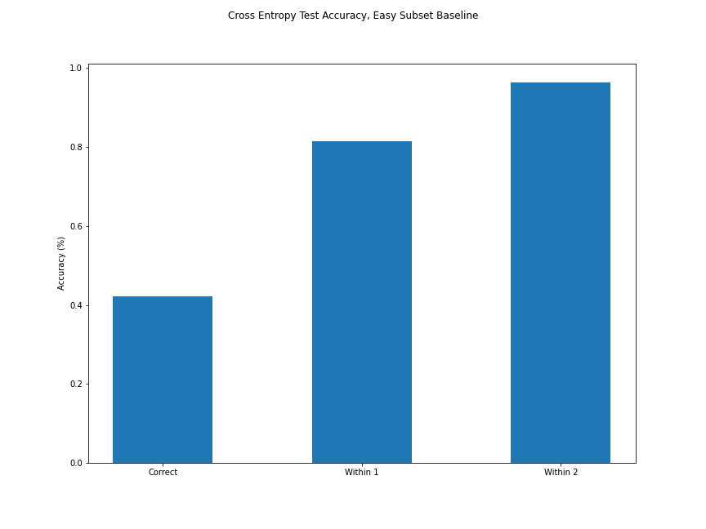
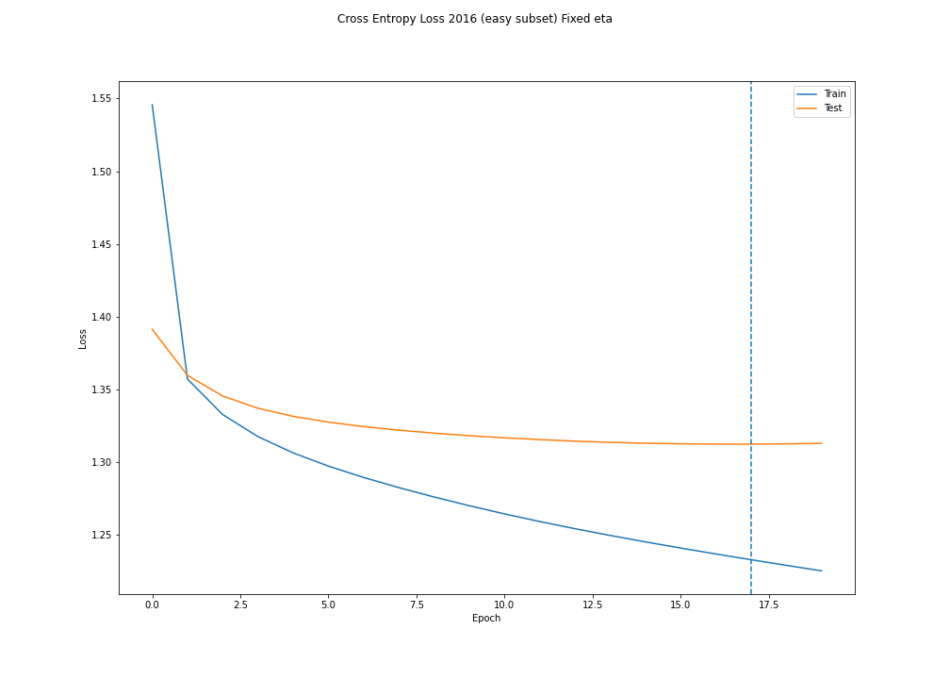
Another method: (Cross Entropy error)
0.4254 & 0.7956

Slide 16
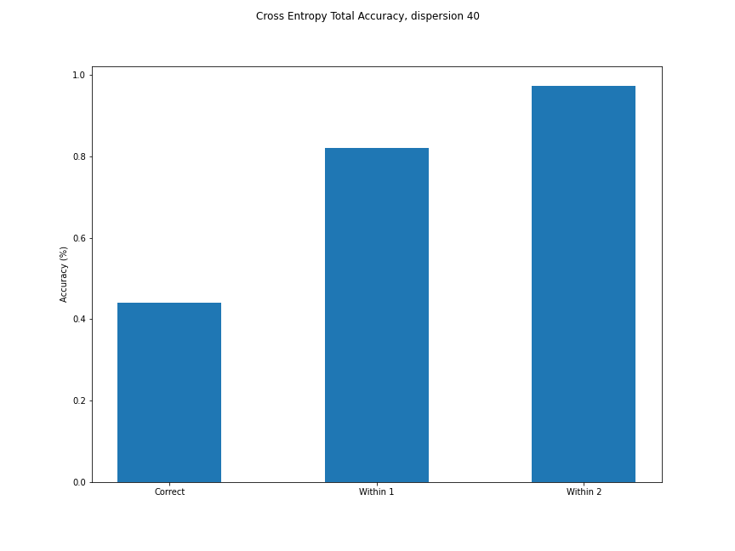
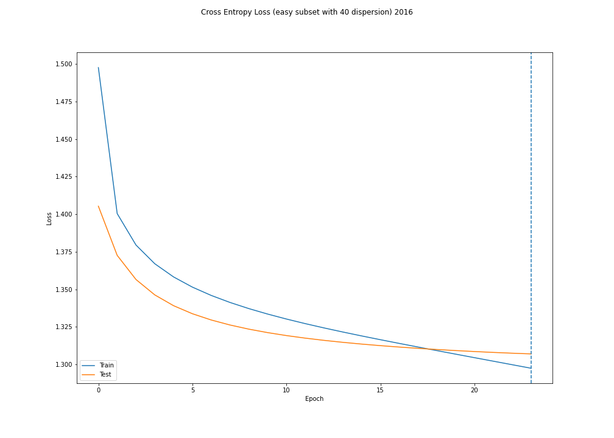
Cross Entropy error with dispersion
Dispersion: For example, [0 0 1 0 0] disperses into [0 0.3 0.4 0.3 0]

Slide 17
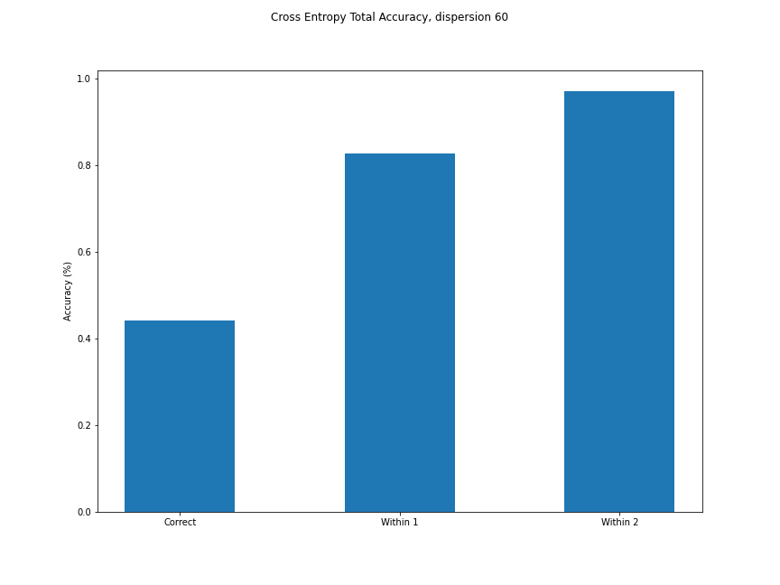
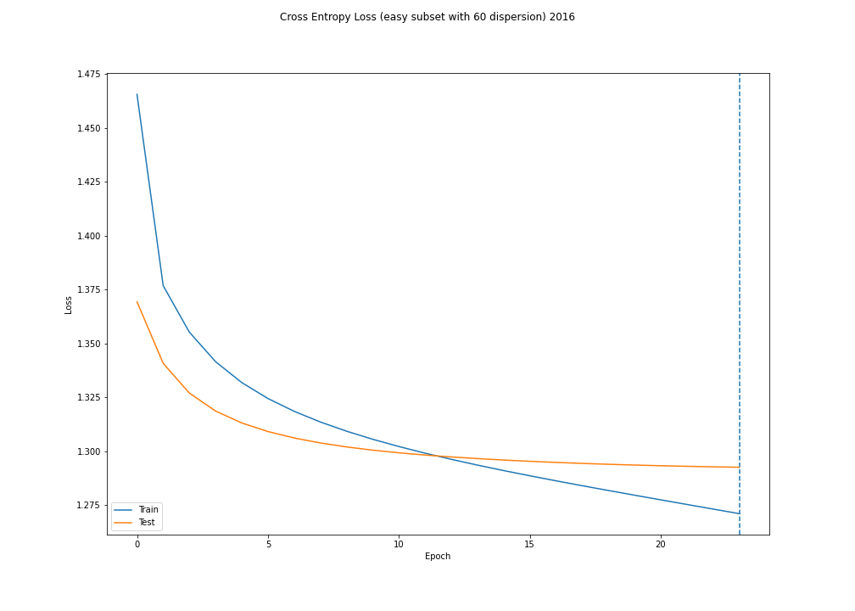
Cross Entropy error with dispersion
Dispersion: For example, [0 0 1 0 0] disperses into [0 0.2 0.6 0.2 0]

Slide 18
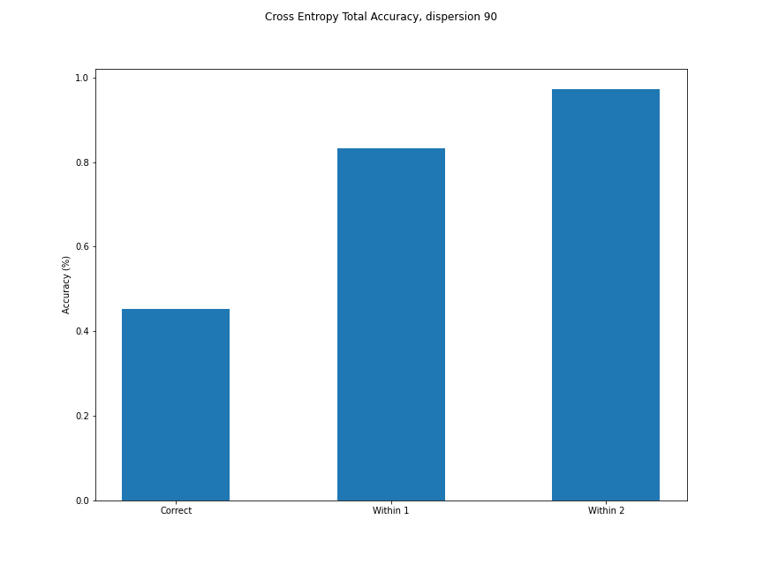
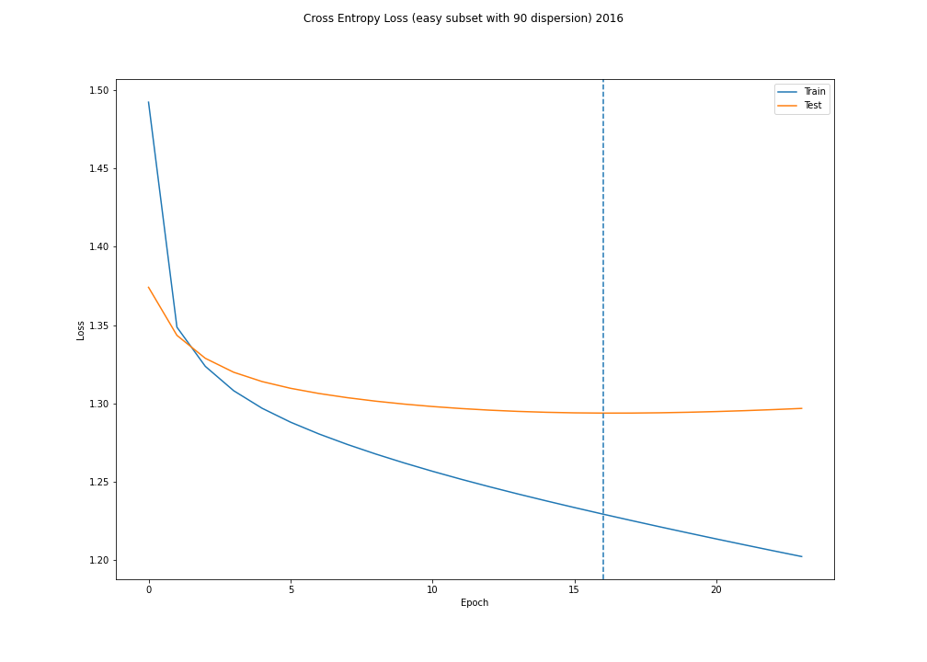
Cross Entropy error with dispersion
Dispersion: For example, [0 0 1 0 0] disperses into [0 0.05 0.9 0.05 0]

Slide 19
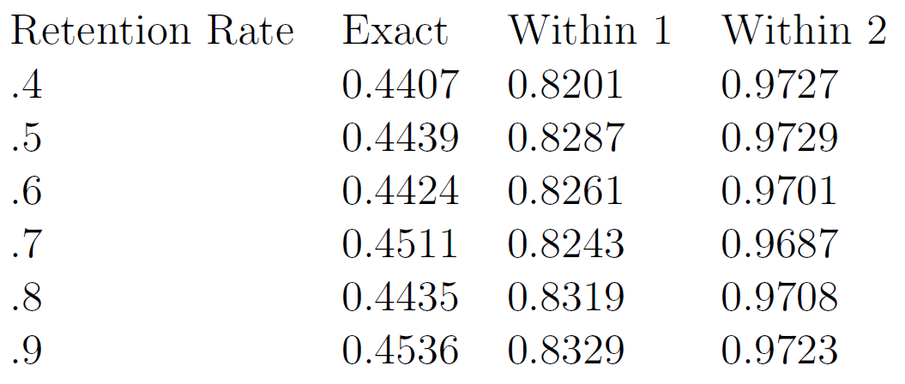
Cross Entropy error with dispersion

Slide 20
Embedding the holds
Notice each problem is a sentence.

Slide 21
Embedding the holds
Construct an Adjacency matrix in this way
problem 1 | [A1, A3, A5]
problem 2 | [A2, A3]
problem 3 | [A1, A5]
 |  | A1 | A2 | A3 | A4 | A5
 | A1 | x |  | 1 |  | 2
 | A2 | x | x | 1
 | A3 | x | x | x |  | 1
 | A4 | x | x | x | x
 | A5 | x | x | x | x | x

Slide 22
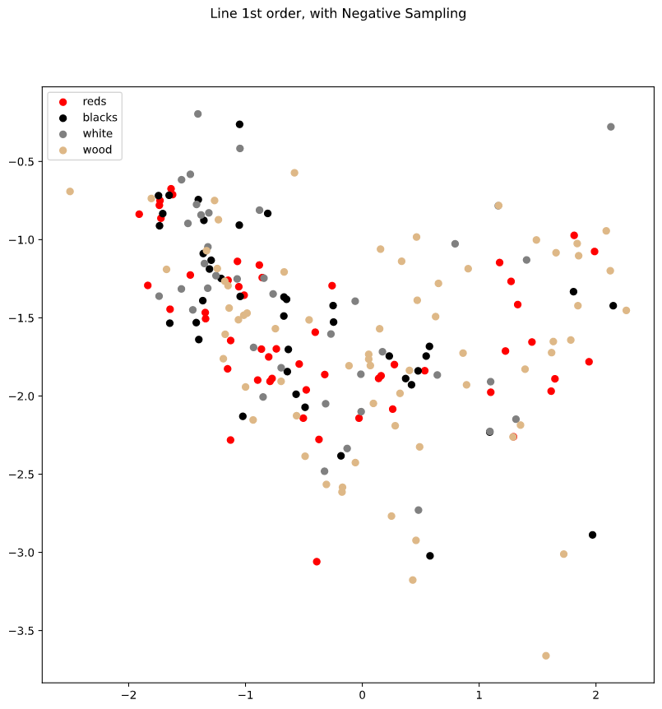
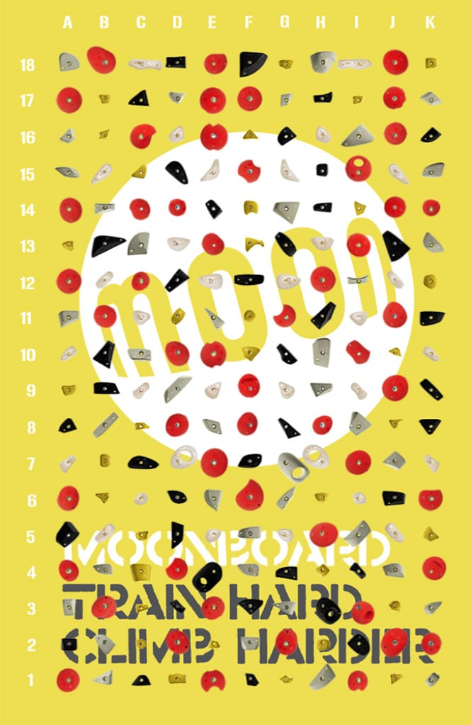
Embedding the holds

Slide 23
To do
Try to create a meaningful embedding of the holds
Calculate F1 scores and predicted scores’ distributions for each grade

